Slide 1

Deep Learning Week 9 LoRa - Enhanced DistilBART: Lightweight News Summarization
Team Perceptron

Slide 2
Problem Motivation
Challenge
Summarizing long news articles into concise, fluent summaries.
Full fine-tuning of large transformers is computationally expensive and
memory-intensive.
Our Goal
Train an efficient, resource-friendly summarization model without
sacrificing performance.

Slide 3
Project Overview
How We Approached the Problem:
Selected a lightweight model and use Parameter-Efficient Fine-Tuning (PEFT) instead of updating all weights.
LoRA for Efficiency: Apply Low-Rank Adaptation to inject small trainable matrices into attention layers, reducing trainable parameters by over 90%.
Focused on adapting a small subset of model parameters rather than retraining everything.

Slide 4
Model and Dataset Choices
Selected Model: distilbart-cnn-12-6, a compressed version of BART with
6 encoder and decoder layers.
Why DistilBART?: 40% fewer parameters, faster training, and lower memory usage,
ideal for low-resource settings.
Dataset: CNN/DailyMail v3.0.0 — a large-scale news summarization benchmark;
strong alignment with model’s pretraining domain.
Subset Selection: Used 3% of the full dataset (~8.6k samples) to fit within 8GB
memory without sacrificing the learning process.

Slide 5
What is LoRA and How We Used It
What is LoRA? Introduces small, low-rank weight matrices into key/value projection
layers (q_proj, v_proj) inside transformer attention blocks
Training Focus: Only LoRA parameters are trained, keeping the main model mostly
frozen, significantly reducing memory needs.
LoRA Config Settings
Rank = 8; Scaling Factor = 16.
LoRA weights are merged back into the base model after training for zero additional inference cost.
Implementation: Used Hugging Face’s peft library for easy adapter integration.

Slide 6
Training Pipeline Setup
Hyperparameters
Efficiency Techniques
Mixed Precision (float16) for faster computation and lower memory use on MPS (Mac GPU).
Strict sequence truncation and padding to ensure uniform tensor sizes, avoiding memory spikes.
Parameter | Value
Batch Size | 4
Learning Rate | 1e-4
Epochs | 10
Max Input Length | 512
Max Target Length | 64
Random Seed | 42
Gradient Accumulation | 8

Slide 7
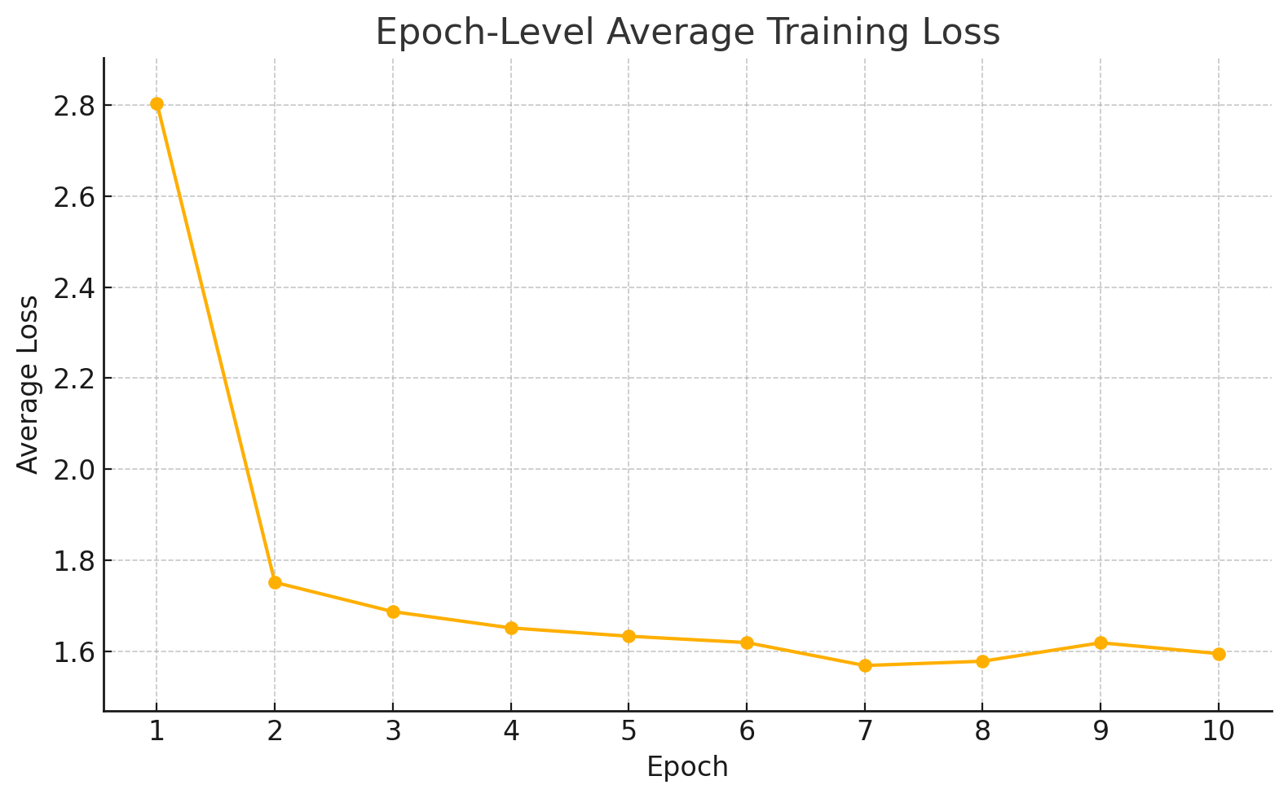
Epoch-Level Training Loss Analysis

Slide 8
Evaluation Methodology
Evaluation Metrics
ROUGE-1 & ROUGE-2: Measure unigram and bigram overlap between model outputs and human references, reflecting the model’s ability to reproduce individual content words (ROUGE-1) and short, coherent phrases (ROUGE-2).
ROUGE-L & ROUGE-Lsum :Compute the longest common subsequence (LCS) without requiring contiguous matches. ROUGE-L emphasizes sentence-level structural similarity, while ROUGE-Lsum adapts LCS scoring for multi-sentence summaries, ensuring coverage of all main points.
BLEU: Assess the precision and fluency of generated outputs.

Slide 9
Results and Insights
Performance Gains
→ LoRA-fine­tuned model
ROUGE-1 : 0.4238 (+0.0228)
ROUGE-2 : 0.2110 (+0.0160)
ROUGE-L : 0.3032 (-0.0004)
ROUGE-Lsum : 0.3630 (-0.0491)
BLEU : 0.1309 (+0.0129)
→ Baseline DistilBART (unadapted):
ROUGE-1: 0.4010
ROUGE-2 : 0.1950
ROUGE-L : 0.3036
ROUGE-Lsum : 0.4121
BLEU : 0.1180

Slide 10
Challenges
Technical Challenges
Dependency conflicts between Python packages like FastAPI, Gradio, Pydantic required
careful management.
Slow inference on Mac MPS initially; mitigated by merging adapters and using
mixed-precision inference.
Limitations
Evaluation focused only on CNN/DailyMail domain — future testing on diverse datasets needed.
Generalizability to other text styles (scientific, conversational) remains untested.

Slide 11
Future Directions
Broader Testing: Fine-tune and evaluate on different domains like scientific or conversational text (e.g., XSum, PubMed).
PEFT Comparisons: Compare LoRA with other techniques like Prefix-Tuning and Adapter Tuning to better understand trade-offs.
Multilingual Capability: Extend the model to work across languages using mBART or mT5.
Ethical Concerns: Add human-in-the-loop verification to avoid risks of hallucination and biased summaries

Slide 12
Conclusion
LoRA enables powerful fine-tuning with a fraction of parameters, democratizing NLP.
Achieved measurable performance gains with minimal resources.
This approach shows that high-quality summarization is achievable even without access to large-scale GPU clusters
Vision: Expand this work to broader domains, languages, and deploy responsible summarization systems.

